Slide 1
Placeholder confidentiality disclosure.

Slide 2
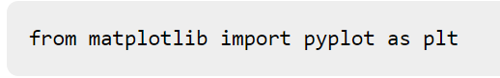
Matplotlib
Python library used to create 2D graphs and plots by using Python scripts
Consists of a module pyplot which supports a very wide variety of graphs and plots - histogram, bar charts, power spectra, error charts etc.
Also provides features to control line styles, font properties, formatting axes etc., making things easier for plotting
Importing the package into Python script:

Slide 3
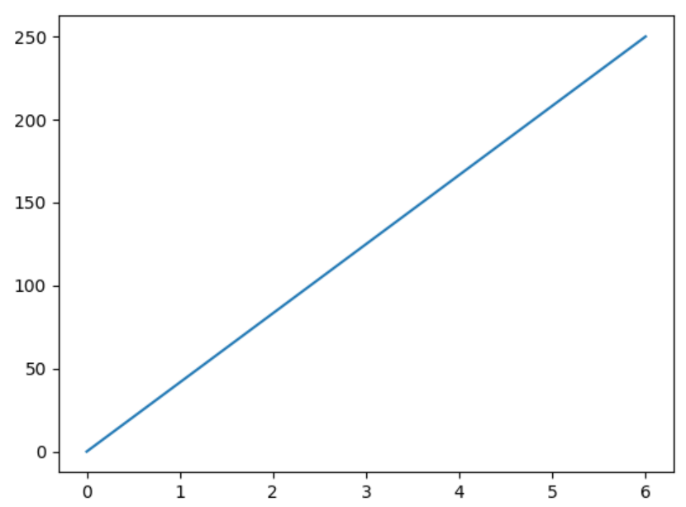
Example:
Line graph from position (0,0) to (6,250)
Code:
import matplotlib.pyplot as plt import numpy as np xpoints = np.array([0, 6]) ypoints = np.array([0, 250]) plt.plot(xpoints, ypoints) plt.show()
Output:

Slide 4
Seaborn
Seaborn is an open-source Python library built on top of Matplotlib.
Provides many color palettes and default beautiful styles to make statistical plots in Python more attractive.
Plot: Plots are generally used to make visualization of the relationships between the given variables. These variables can either be a categorical or can be completely numerical variables.
Different categories of plots in Seaborn:
Distribution plots
Relational plots
Regression plots
Categorical plots
Multi-plot grids
Matrix plots

Slide 5
How to select a meaningful Visualization
3 steps: Preparing Data, Visualizing Data, Styling Data
Choosing chart types:
Focusing question you want to answer with your chart
Type of data you want to visualize
Chart Categories:
Composition Charts: What are the parts of some whole? What is the data made of?
Distribution Charts: How values in your data are distributed across variables?
Relationship Charts: How do variables relate to each other?
Comparison Charts: How do variables compare to each other?

